Slide 1



Slide 2
STAR WARS GAME
NAME OF THE BATCH
S.MEGHA 911019104010
R.SARANYA 911019104023
A.SWATHI 911019104027
NAME OF THE GUIDE
Mrs .K . RANI M.E ( Ass .Prof ./CSE)

Slide 3
ABSTRACT
Star Wars Game is a well- known game among children even among matured people.
This game comes with a single player mode.
This Star War Game in python is an easy game for all.
The graphics of the game play system is good and smooth to control for the users.
Talking approximately the game play of the system, the gambling strategies are too easy, all you need to do is simply pass round and hit enemies through firing bullets.
The game is controlled through a keyboard (up, down, right, left arrow keys). It means that the more you crash or hit enemies through bullets, the more a highest game score to get.
When the enemies crashed with your plane then the game is over and again you have to start a new game.

Slide 4
ADVANTAGE
Star wars Game is very easy to play for children.
Star wars game in python is an easy game for all.
It is good and smooth to control for the user.
The game is controlled through a keyboard
(up , down , right arrow key , left arrow key).

Slide 5
SOFTWARE SPECIFICATION
Python provides a built –in library called pygame Which used to develop the game.
Once we understand the basic concepts of python programming.
We can use the pygame library to make games with attractive graphics, suitable animation and sound.
pygame is a cross-platform library that is used to design video games.

Slide 6
SYSTEM SPECIFICATION
Hardware Specification
PROSESSOR : AMD PRO A4-4350B R4
RAM : 4 GB
HARD DISK : 430.7 GB
Software Specification
OPERATING SYSTEM : Windows 10
BACKEND : python

Slide 7
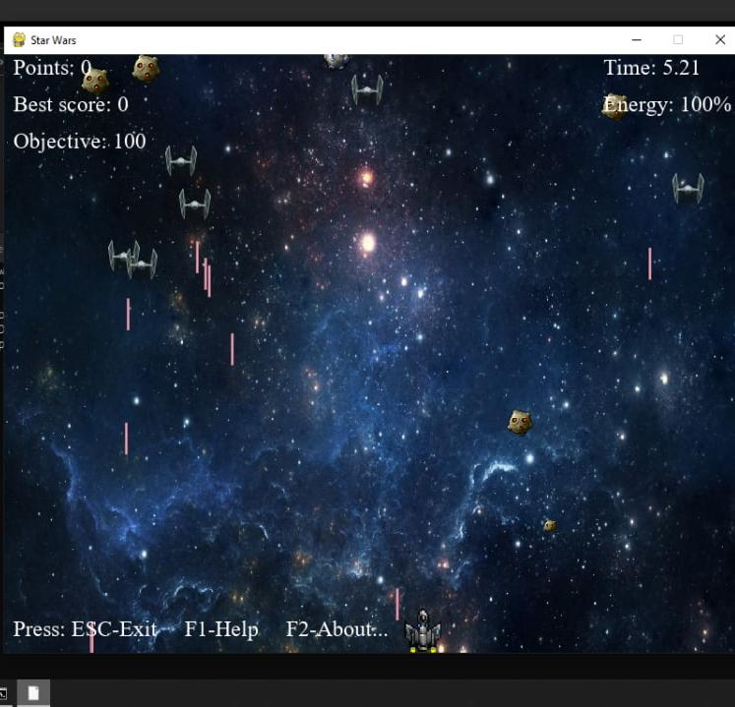
RESULT

